Slide 1
Codesys_Sequential motor starter program.
June 2019
Jamal Muhammad
Automation Designer
Extrude Hone GmbH

Slide 2
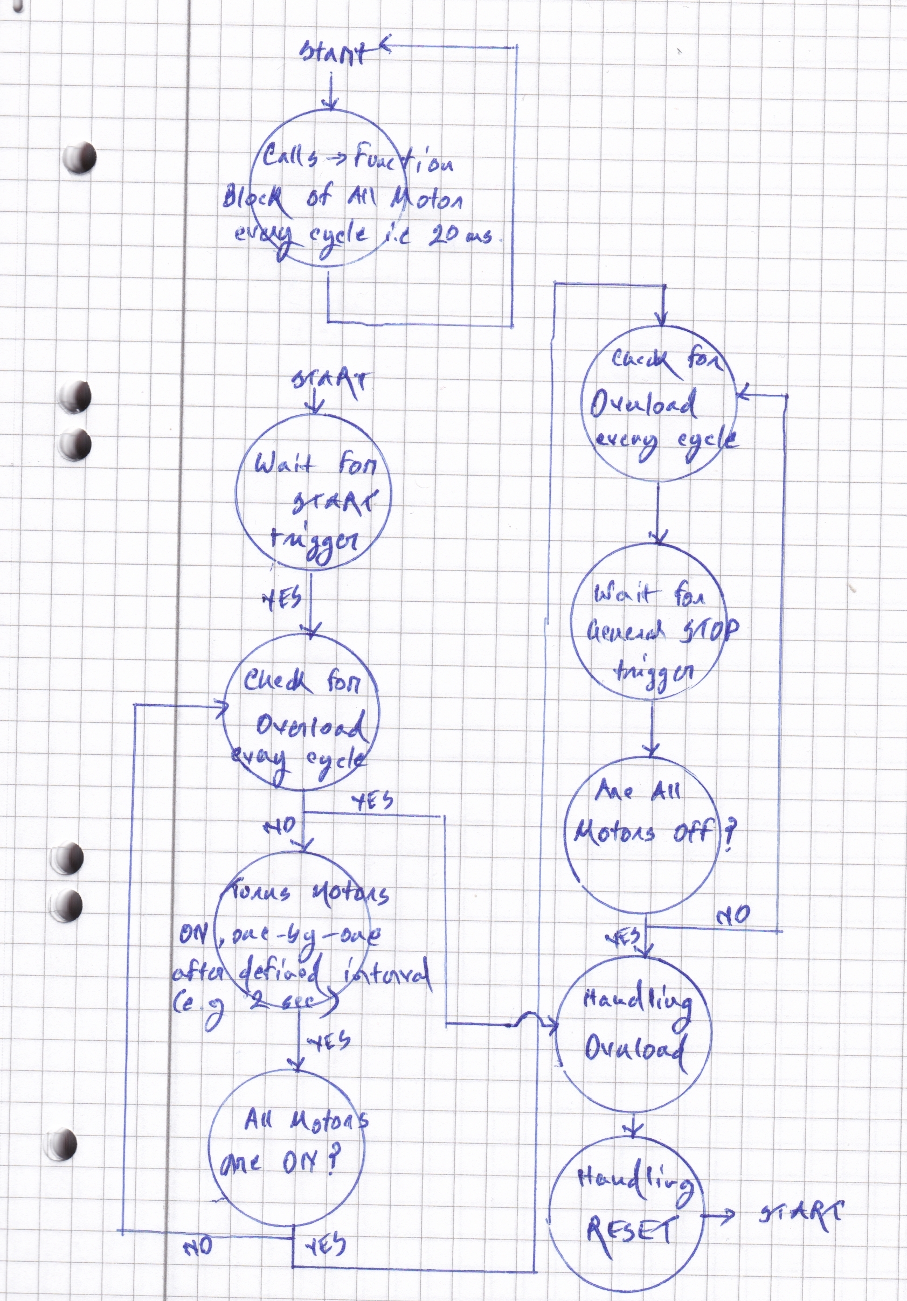
Program Algorithm

Slide 3
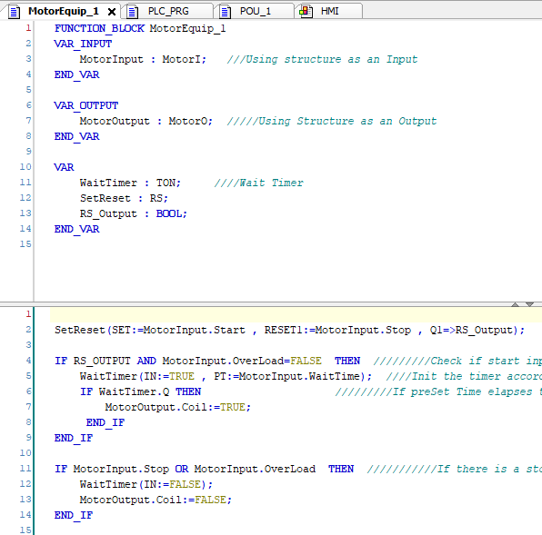
Function Block -- > MotorEquip_1

Slide 4
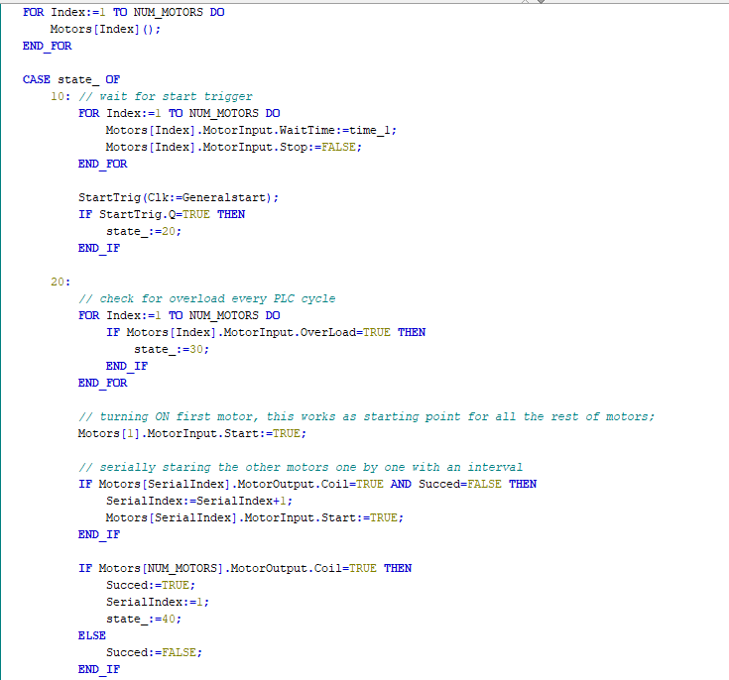
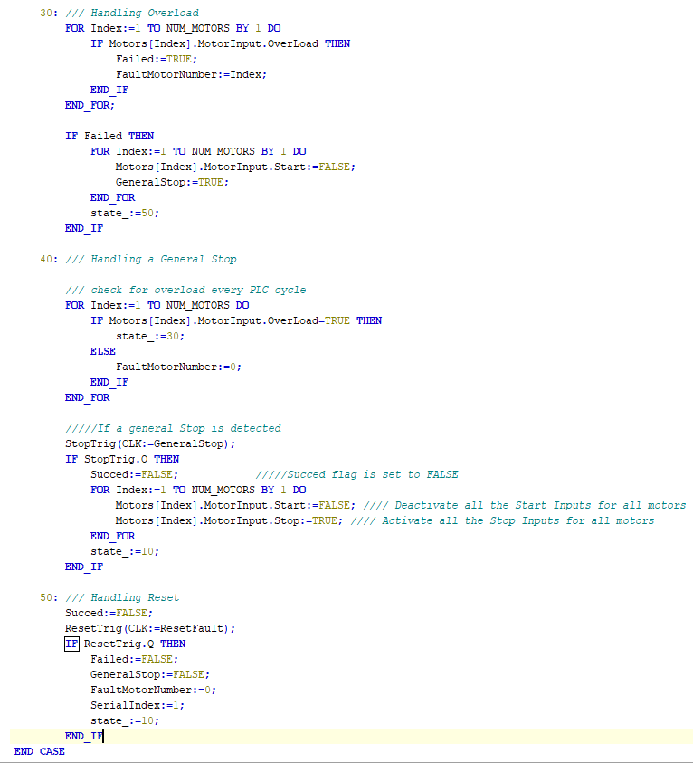
PLC code in Structured Text

Slide 5
Thank You!
June 2019
Jamal Muhammad
Automation Designer
Extrude Hone GmbH

